Slide 1




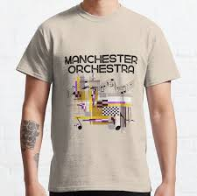
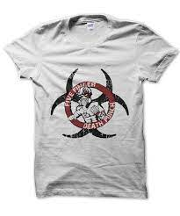
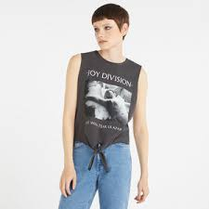
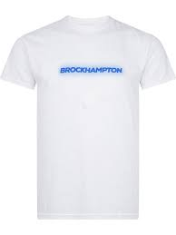
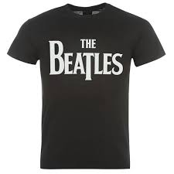
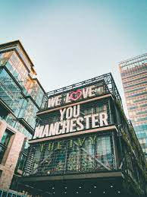


BUZZ
FLASH DEAL!
Use code BUZZ50 for 50% off all T-shirts
Blog posts
New & Trending
Discounts
The Coolest New Fashion Brands in Manchester
Check out the latest up an coming stores in Manchester – it’s giving *ALL of the inspo
10 fashion influencers you *should be following
Best Discounts out now
New to Manchester?
Outfit Inspo
More this way

